Slide 1
Rationale to select Scientific problem
Prof. Krishna Misra
Department of Applied Sciences
Indian Institute of Information Technology, Allahabad
July 30, 2018

Slide 2
Qualities for research career
Curiosity to investigate in depth
Good organizer
Patience
Honesty
Aptitude for good expression in speech and writing
Capable of thinking independently
Ability to work in a team
Total commitment

Slide 3
India’s empowerment through Science & Technology
No nation can achieve economic independence, cultural and social progress without Science and Technology.
Major problems facing India can only be solved through Innovative Technology
Since majority population lives in villages, emphasis should be on “Rural Technology” mainly Agriculture.

Slide 4
Changing phases of National policies in S &T
India’s Scientific Policy Resolution(SPR) of 1958 resolved to “foster, promote and sustain the cultivation of science in all respects” Technology was the expected outcome.
The Technology Policy Statement (TPS) of 1983 emphasized the need to attain technological competence & self reliance.
The Science and Technology Policy of 2003(STP) brought S & T together, emphasizing investment in science.
“Science, Technology and Innovation (STI) for the people “ is the new paradigm of the Indian STI enterprise (declared in January, 2013 in Science Congress at Kolkata).
India has declared 2010-2020 as the “decade of innovation”
STI’s contribution to economic wealth of the country will determine India’s global competitiveness.

Slide 5

Science, Technology & Innovation
Science ….Applied science …… Technology
Invention………………..Innovation
Original model of three phases of Technological Change

Slide 6
Technology
Technology is a combination of knowledge, techniques and concepts
It is tools and machines, farms and factories.
It is organization, processes and people.
In short, it is the science and the art of getting things done - through application of skills and knowledge.

Slide 7
Science, Technology and Innovation
Science, Technology and Innovation Solve, Transform and Impact
Innovation is the development of new values through solutions that meet new requirements, inarticulate needs, or old customer and market needs in value adding new ways.
This is accomplished through more effective products, processes, services, technologies, or ideas that are readily available to markets, governments, and society.

Slide 8
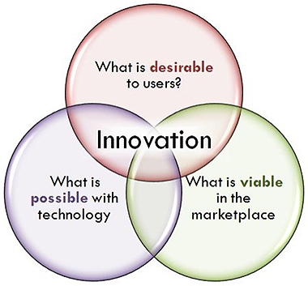
INNOVATION

Slide 9
Major issues facing India today
1. Sustainable Agriculture
2. Drinking water
3. Food (hunger/malnutrition)
4. Health
(i) Clean environment
(ii) cheap medicines
5. Facilities for science education
6. Participation of women in all programs

Slide 10
How to select a research topic
Be aware that selecting a good topic may not be easy. It must be narrow and focused enough to be interesting, yet broad enough to find adequate information.
Before selecting your topic, make sure you know what your final project should look like.
Each researcher will likely require a different format or style of research project.
Brainstorm for ideas
Choose a topic that will enable you to read and understand the literature
Ensure that the topic is manageable and that material is available
Make a list of key words
Be flexible
Define your topic as a focused research question
Research and read more about your topic
Formulate a thesis statement

Slide 11
Choose a topic that interests you
Use the following questions to help generate topic ideas.
Do you have a strong opinion on a current social or political controversy
Did you read or see a news story recently that has piqued your interest or made you angry or anxious?
Do you have a personal issue, problem or interest that you would like to know more about?
Do you have a research paper due for a class this semester?
Look at some of the following topically oriented Web sites and research sites for ideas

Slide 12
How to choose the topic?
Are you interested in health , nutrition or medicine?
Look in Healthfinder.gov, (US government directory of online publications, clearinghouses, databases, web sites, and support and self-help groups, as well as the government agencies)
Health & Wellness Resource Center (Univ. Connecticut;Contains scholarly and popular articles on all aspects of medicine, health, and alternative health. Also includes health-related videos, medical & alternative health encyclopedias, health assessment tools, and a drug and herb finder). or
the National Library of Medicine (NLM) on the campus of NIH in Bethesda, Maryland, is the world's largest medical library.
Are you interested in current events, government, politics or the social sciences?
Try Washington File (From US Embassy in India)
Are you interested in the Humanities; art, literature, music?
Browse links from the National Endowment for the Humanities (neh.gov) NEH is an independent grant-making agency of the United States government dedicated to supporting research, education, preservation, and public programs
Write down any key words or concepts that may be of interest to you. Could these terms help be used to form a more focused research topic?
Ask the supervisor or a senior scientist for ideas if you feel you are stuck or need additional guidance.

Slide 13
Public Health Foundation of India (PHFI)
Office
Delhi NCR
Plot No. 47, Sector 44,
Institutional Area Gurgaon – 122002
Phone: 01244722900/ 01244781400
Registered office
ISID Campus 4 Institutional Area Vasant Kunj, New Delhi – 110070 India
Phone: +91 11 49566000 Email: contact@phfi.org
Other offices are at Ahmedabad, Hyderabad, Bhubaneswar and Shillong.

Slide 14
Read General Background Information
Read a general encyclopedia article on the top two or three topics you are considering.
Notice that both online encyclopedias provide links to magazine articles and Web sites. These are listed in the left or the right margins.
Reading a broad summary enables you to get an overview of the topic and see how your idea relates to broader, narrower, and related issues. It also provides a great source for finding words commonly used to describe the topic. These keywords may be very useful to your later research.
If you cant find an article on your topic, try using broader terms and ask for help from a librarian.
Use periodical indexes to scan current magazine, journal or newspaper articles on your topic. Ask a librarian if they can help you to browse articles on your topics of interest.
Use Web search engines. When you think search, no doubt you think Google. But there are other popular major search engines (e.g., Bing, Yahoo, Yandex, and Baidu) .
Google and Bing are currently considered to be two of the best search engines to find web sites on the topic.

Slide 15
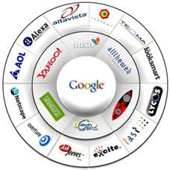
Search Engines

Slide 16
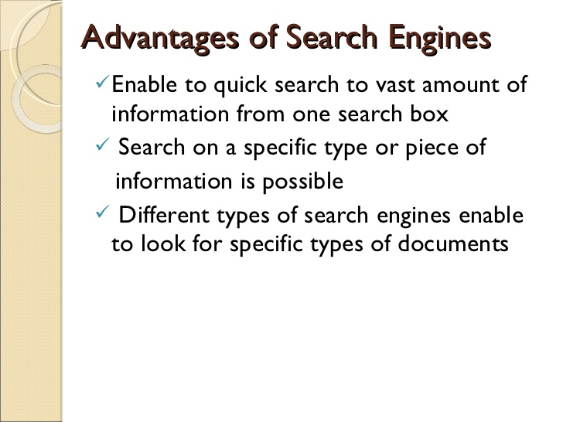

Slide 17
Scientific Search engine
PUBMED
PUBMED Central
BIOMED Central (Owned by Springer Nature)
SCIRUS: With over 460 million scientific items indexed
Elsevier Science Direct
Google Scholar
Google Scholar citation index generator
Google H-Index for citation ration of a author, suggested in 2005 by Jorge E. Hirsch,also known as Hirsch number or Hirsch index.
Scopus :The largest abstract and citation database

Slide 18
PUBMED/MEDLINE/NCBI
MEDLINE is the U.S. National Library of Medicine (NLM) premier bibliographic database that contains more than 23 million references to journal articles in life sciences with a concentration on biomedicine. A distinctive feature of MEDLINE is that the records are indexed with NLM Medical Subject Headings (MeSH).
The PubMed medical citation and article search lets you find bibliographic information from MEDLINE as well as extra life science journals, out-of-scope citations, and citations preceding the date that a journal was selected. The search provides access to over 17 million bio-medical citations / articles from MEDLINE and other journals. This extensive library of medical literature resources date from the 1950's to the current date.
The citations used in the PubMed search have been submitted by the publisher to NCBI{National Center for Biotechnology Information (NCBI)}. before (or at the time) of publication.

Slide 19
PubMed and PubMed Central (PMC) — What is the Difference?
PubMed is home to approximately 21 million citations and abstracts
PMC is home to approximately 2 million free full-text articles
PubMed:
Began in 1996, born out of MEDLINE
Is a database comprising citations and abstracts from the MEDLINE biomedical literature, as well as from life sciences journals and online books
Includes links to full-text articles at several thousand journal web sites as well as to most of the articles in PMC
PMC:
Began in 2000, born out of a 1998 conversation between two distinguished scientists at a San Francisco bakery (Ralph Nader and Claire)
Is a free archive containing more than two million full-text biomedical and life sciences journal articles and serves as a digital counterpart to NLM’s extensive print journal collection
Includes links to corresponding citations in PubMed and contains certain types of literature such as book reviews, which are not included in PubMed

Slide 20
Focus on Your Topic
Keep it manageable
A topic will be very difficult to research if it is too broad or narrow. One way to narrow a broad topic such as "the environment" is to limit your topic. Some common ways to limit a topic are:
by geographical area e.g. What environmental issues are most important in the Southwestern India?
by time frame: e.g. What are the most prominent environmental issues of the last 10 years?
by discipline e.g. How does environmental awareness effect business practices today?
(iv) by population group e.g. What are the effects of air pollution on senior citizens?
Topic may be too difficult to research if it is too:
(v) locally confined - Topics this specific may only be covered in local newspapers, if at all.
Example: What sources of pollution affect the Delhi state water supply?
(vi) Recent - If a topic is quite recent, books or journal articles may not be available, but newspaper or magazine articles may. Also, Web sites related to the topic may or may not be available.
(vii) broadly interdisciplinary - You could be overwhelmed with superficial information.
If you have any difficulties or questions with focusing your topic, discuss the topic with your senior, or with a librarian

Slide 21
Make a List of Useful Keywords
Keep track of the words that are used to describe your topic.
Look for words that best describe your topic
Look for them in when reading encyclopedia articles and background and general information
Find broader and narrower terms, synonyms, key concepts for key words to widen your search capabilities
Make note of these words and use them later when searching databases and catalogs

Slide 22
Be Flexible
It is common to modify your topic during the research process. You can never be sure of what you may find. You may find too much and need to narrow your focus, or too little and need to broaden your focus. This is a normal part of the research process.
While researching, you may not wish to change your topic, but you may decide that some other aspect of the topic is more interesting or manageable.
Keep in mind the assigned length of the research paper, project, bibliography or other research assignment. Be aware of the depth of coverage needed and the due date.
These important factors may help you decide how much and when you will modify your topic.

Slide 23
Define Your Topic as a Focused Research Question
You will often begin with a word, develop a more focused interest in an aspect of something relating to that word, then begin to have questions about the topic.
Ideas = Frank Lloyd Wright or modern architecture
Research Question = How has Frank Lloyd Wright influenced modern architecture?
Focused Research Question = What design principles used by Frank Lloyd Wright are common in contemporary homes?

Slide 24
Research and Read More About Your Topic
Use the key words you have gathered to research in the catalog, article databases, and Internet search engines. Find more information to help you answer your research question.
You will need to do some research and reading before you select your final topic. Can you find enough information to answer your research question? Remember, selecting a topic is an important and complex part of the research process.

Slide 25
Formulate a Thesis Statement
Write your topic as a thesis statement. This may be the answer to your research question and/or a way to clearly state the purpose of your research. Your thesis statement will usually be one or two sentences that states precisely what is to be answered, proven, or what you will inform your audience about your topic
The development of a thesis assumes there is sufficient evidence to support the thesis statement.
For example, a thesis statement could be: Frank Lloyd Wright's design principles, including his use of ornamental detail and his sense of space and texture opened a new era of American architecture. His work has influenced contemporary residential design.
The title of your paper may not be exactly the same as your research question or your thesis statement, but the title should clearly convey the focus, purpose and meaning of your research.
For example, a title could be: Frank Lloyd Wright: Key Principles of Design For the Modern Home

Slide 26
Major Factors to be Considered in Selecting a Research Problem
In most cases, subject that is overdone must not be picked, because it will certainly be a complicated task to throw any new light in such a situation.
Too narrow or too un-explainable problems must be shunned.
The significance of the topic, the qualifications and the training of a researcher, the expenses required, the time element are few other criteria that should be considered when selecting a problem.
A professional needs to ask himself the following questions:
(a) Whether he /she is properly equipped when it comes to his background to handle the research?
(b) Whether he/she has the budget to afford the research?
(c) Whether the required cooperation can be obtained from relevant scientists.
An average researcher should avoid controversial subjects.

Slide 27
Pick a familiar and feasible topic
The topic picked for research must be familiar and feasible so that the relevant research material or sources of research are within one’s reach.
Even then it is extremely challenging to provide definitive ideas regarding how a professional should obtain ideas for his research. To do this, a researcher can make contact with an expert or a senior scientist who is already involved in research.
Read articles or blog posts published in current literature available on the topic and think the way the methods and concepts talked about therein could be applied to the solution of other problems.
A preliminary study should be done before picking a research problem. This isn’t always required when the problem demands the conduct of a research closely comparable to one that was already done.
However when the field of investigation is pretty new and doesn’t have available a set of well developed methods, a quick feasibility study should always be carried out

Slide 28
Criteria for Selection of Good Research Topic
A researcher must identify the major factors to be considered in selecting a research problem.
The topic should be selected appropriately by paying attention to the above stated key points.
The problem selected should involve the researcher and should have an upper most place in his mind so that he could tackle all pains required for the research study.
See more at: http://universalteacher.com/1/selecting-a-research-problem/#sthash.knzsScJi.dpuf

Slide 29
Concluding remark
The most important thing in choosing a topic for research is extensive reading. If you know all aspects of a particular problem the concept to add to the existing knowledge will automatically crop up in your mind. Even in most extensively worked out fields there remain always a gap for improvement. Fill up that gap according to your own capability and available infrastructure.

Slide 30


